Slide 1


Slide 2
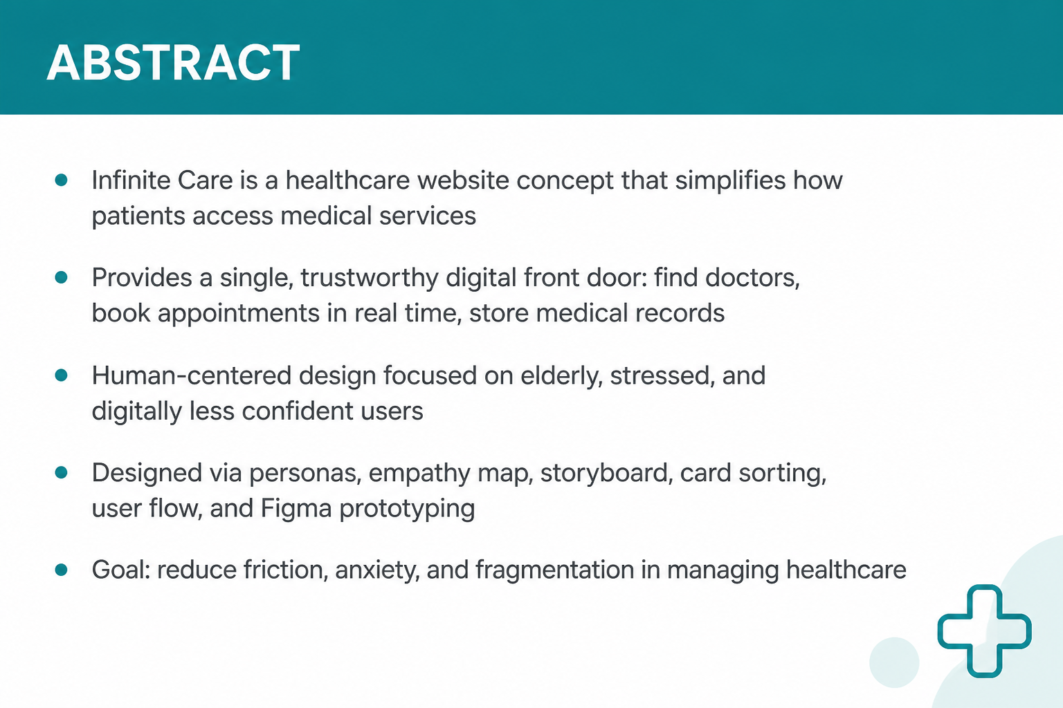
ABSTRACT

Slide 3
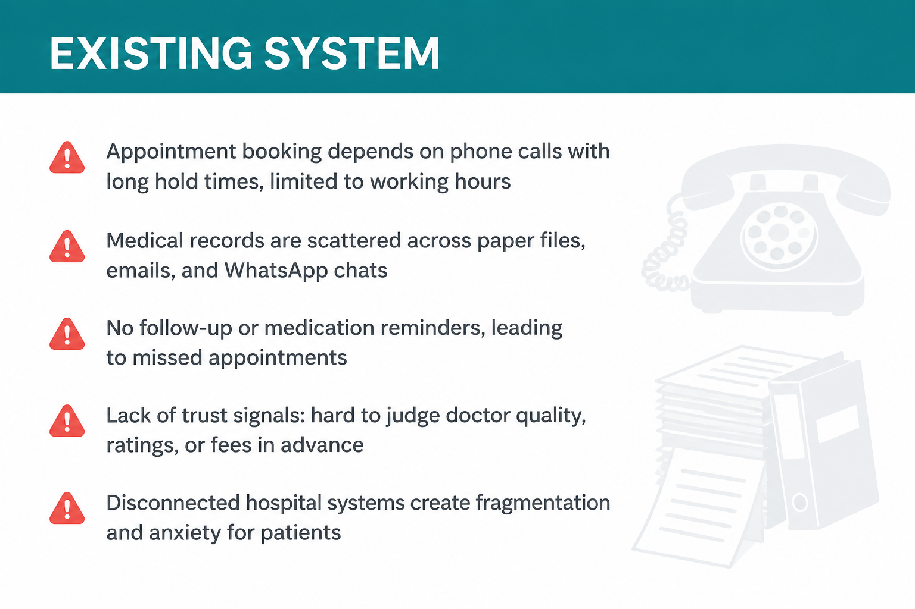
EXISTING SYSTEM

Slide 4
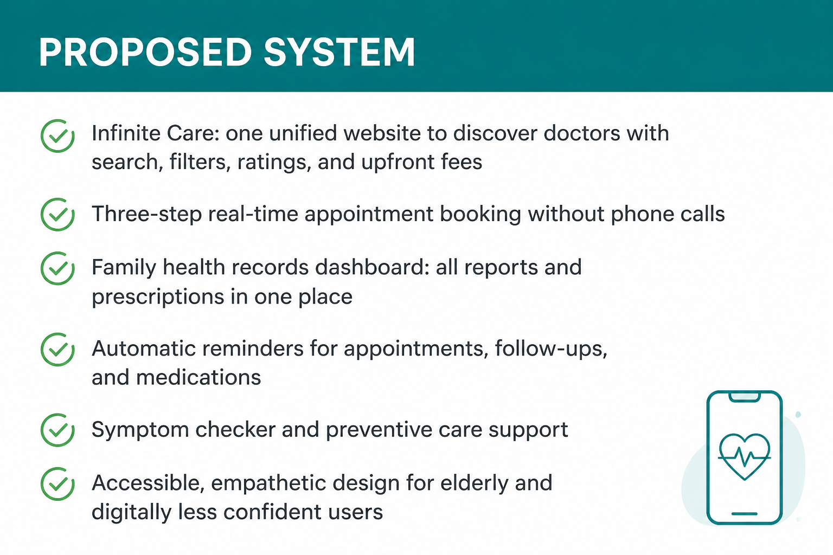
PROPOSED SYSTEM

Slide 5
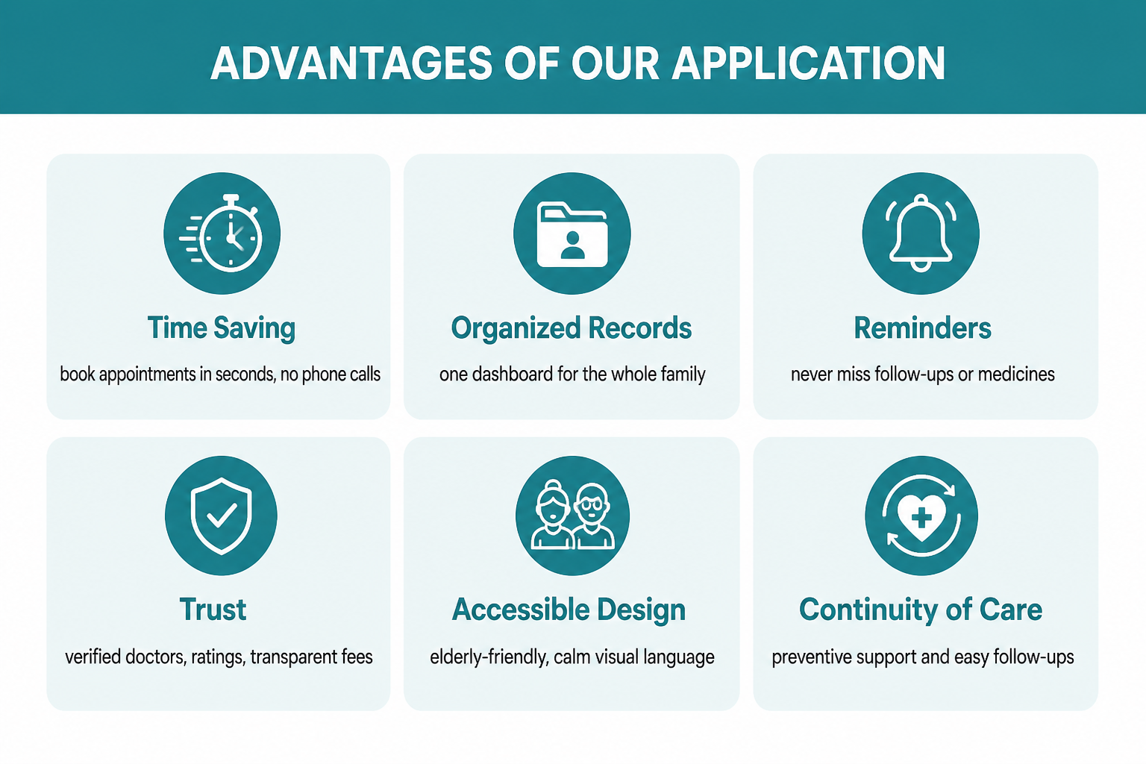
ADVANTAGE OF YOUR APPLICATION

Slide 6
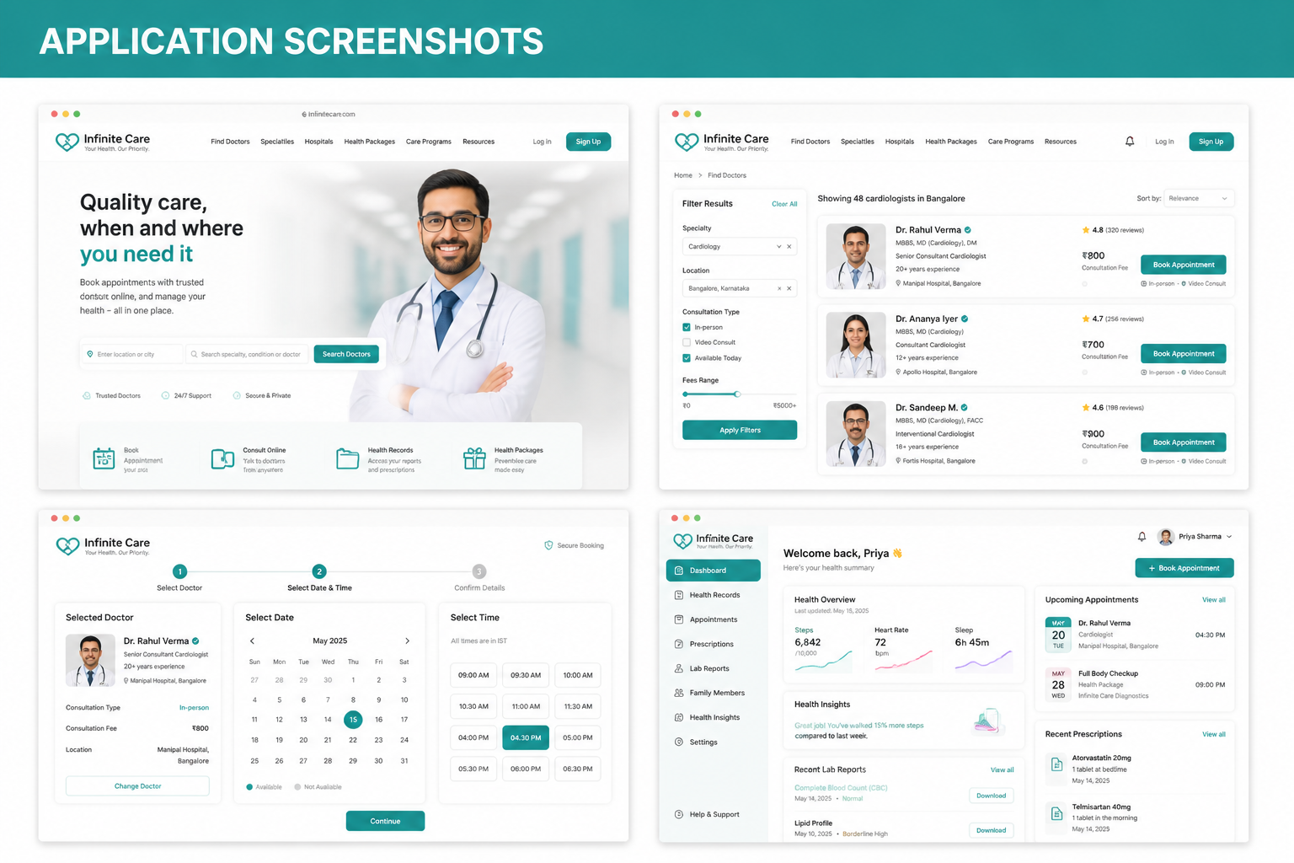
APPLICATION SCREENSHOTS(4)

Slide 7

THANK YOU

